Slide 1

GEO Readiness Audit: The Complete 19-Brand Portfolio
Generative Engine Optimization Scorecard — Domestic & International
Date: March 2026
Prepared for: Alex & Global Sales Force Leadership

Slide 2

Why This Matters — AI Search Is Replacing Google
When someone asks "best movers" or "best international movers," AI pulls answers from structured data, Reddit, and authoritative websites.
■
40%+
Generative Engine Optimization (GEO) case studies show AI referrals convert at 3x the rate of traditional search traffic.
■
Of all searches globally now go through AI-powered engines.
The 19-brand conglomerate is a massive competitive advantage — but only if the sites are technically ready for AI to read them.
■

Slide 3

Portfolio Overview — 19 Brands Across Two Divisions
Domestic Brands
14 Sites
International Brands
5 Sites
ultimatemovers.net
california-seattleexpress.com
myinternationalmovers.com
crosscountrymovers.com
crosscountrymovingcompany.net
ilovemoving.com
eastcoastwestcoastmovers.com
flatpriceautotransport.com
schmidtmovers.com
kerbmoving.com
ldmovers.com
sunsetmoving.com
longdistancemovers.com
longdistancemovingexperts.com
shepherdmovers.com
longdistanceusamovers.com
state2statemovers.com
tricolongdistancemovers.com
usa-autotransport.com

Slide 4
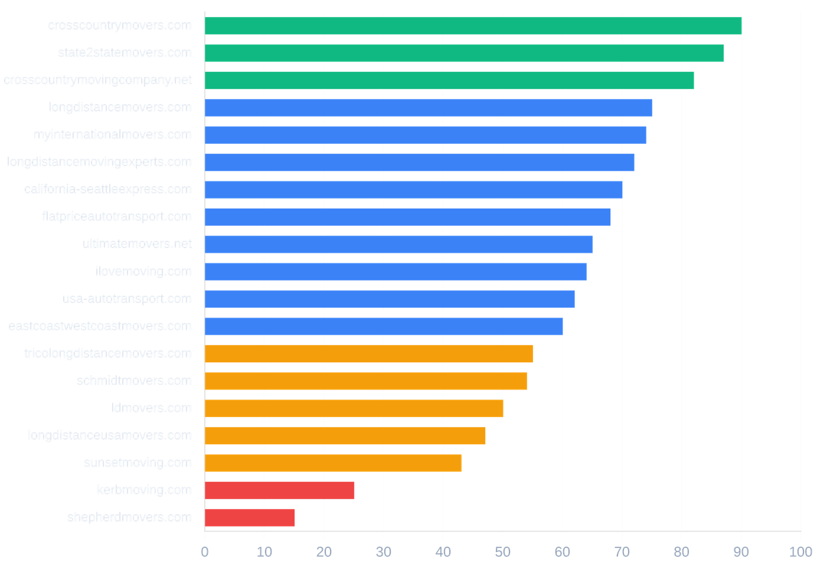
Portfolio-Wide GEO Scores Range from 90 (A) to 15 (F)
COMBINED PORTFOLIO AVERAGE
61/100
TOP PERFORMERS (READY)
crosscountrymovers.com (90, A)
→
state2statemovers.com (87, A)
→
crosscountrymovingcompany.net (82, B)
→
CRITICAL RISK (FAILING)
longdistanceusamovers.com (47, D)
→
sunsetmoving.com (43, D)
→
kerbmoving.com (25, F)
→
shepherdmovers.com (15, F)
→

Slide 5
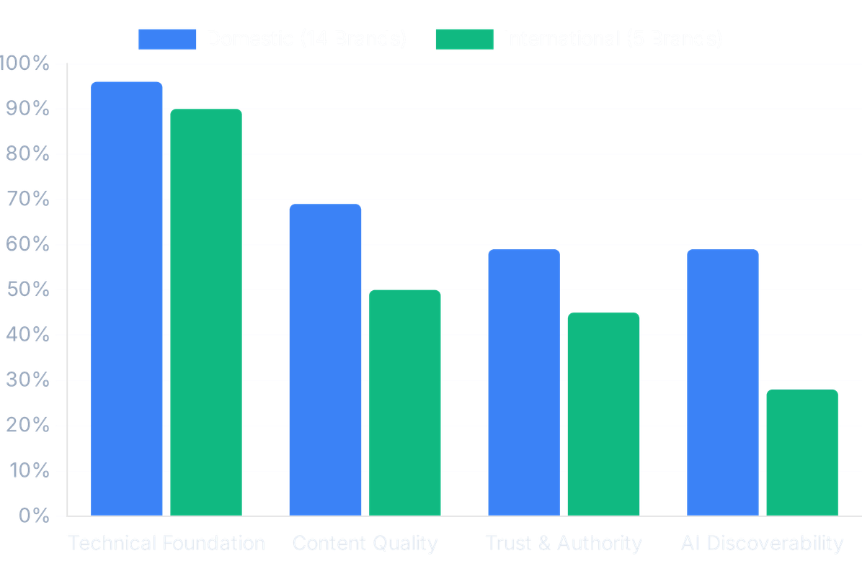
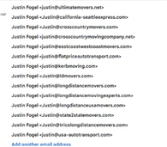
Domestic vs. International — The Gap Is Clear
Domestic Portfolio
Category Comparison: Domestic vs. International
68/100
Solid foundation, needs AI-specific signals
International Portfolio
50/100
Significant gaps in every category

Slide 6

Zero International Sites Have llms.txt — AI Engines Can't Read Them
74%
100%
84%
Missing llms.txt Files
No AI Crawler Directives
No Google Business Profile
Missing on 14 of 19 sites. This file explicitly tells AI engines what the site is about and where to find key information. Zero international sites have it.
Missing on 19 of 19 sites. Not a single site in the portfolio explicitly allows GPTBot, ClaudeBot, or PerplexityBot in their robots.txt file.
Missing on 16 of 19 sites. AI models prioritize entities with verifiable real-world footprints. This is a critical trust signal and a 5-minute fix per site.

Slide 7

Technical Foundation Is Strong; AI Discoverability Is the Critical Failure
Technical Foundation
93% Average (Strong)
Content Quality
62% Average (Moderate)
Trust & Authority
54% Average (Weak)
AI Discoverability
47% Average (Critical Gap)
Entity Authority
Highly Variable Across Portfolio
Strong (80-100%)
Moderate (60-79%)
Weak (50-59%)
Critical (< 50%)

Slide 8

4 Domains Are Actively Losing Leads Every Day
kerbmoving.com
Score: 25 (F)
shepherdmovers.com
Score: 15 (F)
Currently a parked domain redirecting to a streaming article site. The existing llms.txt file actively blocks AI training.
Causes browser crashes due to client-side errors. Missing nearly all GEO signals, including schema, meta descriptions, and AI files.
ldmovers.com
Redirects
sunsetmoving.com
Score: 43 (D)
Redirects to longdistanceusamovers.com, but the main Blog link returns a 404 error. Missing crucial MovingCompany schema.
Contains malformed HTML that AI crawlers cannot parse programmatically. Missing schema and viewport meta tags.

Slide 9
A 4-Phase, 12-Week Plan to Dominate AI Search Across All 19 Brands
PHASE 1
PHASE 2
PHASE 3
PHASE 4
Technical Foundation
Content & Entity Authority
Authentic Community Engagement
Measurement & Scaling
Weeks 1-2
Weeks 3-4
Weeks 9-12
Deploy llms.txt files across all 19 domains
Weeks 5-8
•
Build structured FAQ pages for all 19 brands
•
Track AI Share of Voice across ChatGPT and Perplexity
•
Execute Reddit strategy across domestic and international subreddits
•
Update robots.txt to explicitly allow AI crawlers
•
Implement FAQPage and MovingCompany schema
•
Implement 5-minute lead response SLA
•
Train team on FTC disclosure rules
Fix critical errors on kerbmoving, shepherdmovers, ldmovers, and sunsetmoving
•
•
Upgrade "About Us" pages with real team bios
•
Publish original research report on relocation costs
•
Build account karma via 90% helpful participation
Ensure NAP consistency across directories
•
•
Conduct 90-day ROI review
•
Link Google Business Profiles
•
Host AMA sessions for subtle brand promotion
•

Slide 10
$7,650 - $12,300 Total Investment to Cover All 19 Brands
Resource / Phase
Estimated Cost
Notes
The AI Conversion Advantage
3x
Technical SEO / Web Dev
$3,500 - $5,500
Content Creation
$4,000 - $6,500
Phase 2 (FAQs/Bios)
GEO case studies show that referral traffic from AI engines (ChatGPT, Perplexity) converts at three times the rate of traditional Google search traffic.
Phase 1 Fixes
Community Engagement
Internal Time
AI Tracking Tools
$150 - $300 / mo
Phase 3 (Reddit)
Phase 4
The Speed-to-Lead Multiplier
(Measurement)
21x
Total Estimated Hard Costs
$7,650 - $12,300
The industry average close rate is 39%. However, leads contacted within 5 minutes are 21 times more likely to book. Phase 4 implements this SLA.

Slide 11






From Invisible to Recommended — The 90-Day Transformation
100% AI Crawlability
Structured Answers
All 19 sites fully readable by ChatGPT, Perplexity, and Google AI with proper llms.txt and schema.
19 FAQ pages feeding factual, claim-based answers directly to AI models for user queries.
Authentic Community Presence
Measurable Share of Voice
5+ active Reddit accounts with 100+ karma each, generating earned media mentions safely.
Trackable increases in AI recommendations across both domestic and international moving queries.
Original Research Authority
Optimized Conversion
1 original research report published and cited by AI engines as a definitive industry source.
A strict 5-minute lead response SLA implemented, increasing booking likelihood by 21x.

Slide 12

Approve the Sprint Plan and We Start Monday
1
Approve the 90-Day Sprint Plan (v2.0) covering all 19 brands.
2
Assign web development resources for Phase 1 technical fixes.
3
Designate 3-5 team members for Reddit community engagement training.
4
Approve the budget: $7,650 - $12,300 total hard costs.
"The brands are the asset. The AI engines are the opportunity. The sprint plan is the bridge."

